Slide 1

This Analysis Assessed Bank Loan Analysis Dashboard.
Pharm. Ugwuani Joseph Chinonso
A Personal Data Analytics Project.

Slide 2


Slide 3
Introduction
This analysis assessed Bank loan analytics among different bank customers.
It identified KPIs like total_loan_application, total_fund_amount, total_amount_received, avg_interest_rate, avg_DTI. Good loans vs Bad loans. Performance trend analysis by time, region, and customers.
Findings and recommendations are designed to help bank stakeholders and decision-makers to gain insights and understand loan program. This insight helps in reducing bad loan.
Using Microsoft Excel, data was collected, cleaned with Power Query, Imported into Power BI, aggregated and visualized. Charts, lines and Slicers were used to gain insights on bank loan analytics.

Slide 4
Analysis Objective
This analysis evaluated bank loan KPIs like total applications, funded & received amounts, classify loans into good vs bad loans, performance trend analysis by time, region, and customers, Identify factors affecting approval and repayment, build a Power BI dashboard for insights, and provide data-driven recommendations to improve a better bank loan performance.

Slide 5
Data and Methodology
The dataset used for this was sourced from kaggle.com database platform. It contains key variables such as Id, Address_State, Application_Type, Emp_Length, Emp_Title, Grade, Home_Ownership, Issue_Date, Last_Credit_Pull_Date, Last_Payment_Date, Loan_Status, Next_Payment_Date, Member_Id, Purpose, Sub_Grade, Term, Verification_Status, Annual_Income, DTI, Installment, Int_Rate, Loan_Amount, Total_Acc, Total_Payment.
Data cleaning and transformation were carried out using Excel and Power Query. Power BI were used to analyze, aggregate and filter the data, while Charts, lines and Slicers supported effective visual exploration and trends identification across different variables and bank loan analytics.

Slide 6
ANALYSIS PRESENTATION KEY PERFORMANCE INDICATORS
Bank processed 38,576 loan applications in total, and funding a total of $435.76 million.
Borrowers repaid $473.07 million, indicating strong overall portfolio performance due to principal and interest repayments.
Bank portfolio maintains a healthy loan book, with 86.18% as good loan issued and 13.82% as bad loan issued.
The overall average interest rate is 12.05%, while average DTI is 13.33% respectively.

Slide 7
ANALYSIS INSIGHTS CONT.
This analysis showed that loan demand concentrated in a few states like California, New York, Texas, Florida, and New Jersey receive the highest funding.
Credit risk increases steadily as borrower risk grades decline, charge-off rate increases from Grade A (5.7%) to Grade G (31.3%).
The bank maintained a healthy portfolio with a high repayment rate
Most borrowers continue meeting their repayment obligations, supporting stable revenue generation.

Slide 8
BUSINESS IMPLICATIONS.
Interest income contributes positively to portfolio profitability
Healthy lending portfolio with sustainable repayment performance
Revenue depends heavily on a small number of markets.
Higher-risk borrowers require stricter underwriting and pricing
Opportunity to strengthen this profitable customer segment while managing credit risk.

Slide 9
Summary of Findings
This analysis showed that bank operate a profitable lending portfolio with strong repayment performance.
The primary opportunity lies in balancing loan growth with disciplined risk management.
By strengthening underwriting for higher-risk borrowers, expanding in high-performing markets, and monitoring repayment behavior proactively, the bank improves profitability while reducing future credit losses.

Slide 10
Recommendation and Conclusion
Future growth should focus on expanding quality lending, improving risk controls for lower credit grades, and using data-driven customer segmentation to maximize returns while minimizing defaults.
Implement Early Warning Monitoring by building automated dashboards to flag customers showing missed payments, high debt-to-income ratios, or declining credit quality
Improve customer segmentation by loan purpose, grade, income, employment length, and repayment history. Offer personalized loan products and pricing
Optimize debt consolidation products, since debt consolidation drives the largest demand, develop customized repayment plans, financial education, and early intervention for high-risk borrowers

Slide 11
Recommendation and Conclusion
Strengthen risk-based lending by increasing credit assessment requirements for Grades D through G. Use stricter income verification, debt-to-income limits, and repayment history before approval.
Expand lending in high performing markets by increasing marketing investment and branch partnerships in high performing states while identifying similar emerging markets
Restrict 60 month terms to Grade A-B borrowers with DTI below 15% and income above $60K
Flag all debt consolidation loans (47.2% of portfolio, 49.7% of charge-offs) for a 90-day payment behavior review and restrict new originations to DTI below 18%

Slide 12
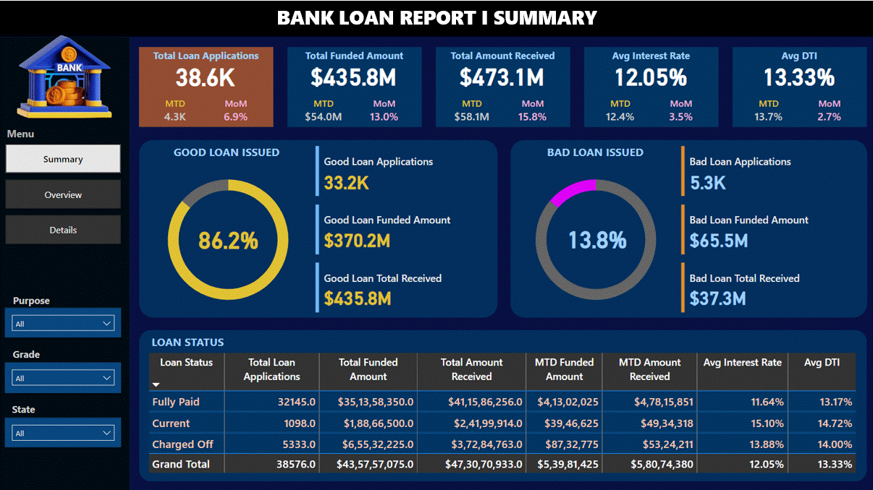
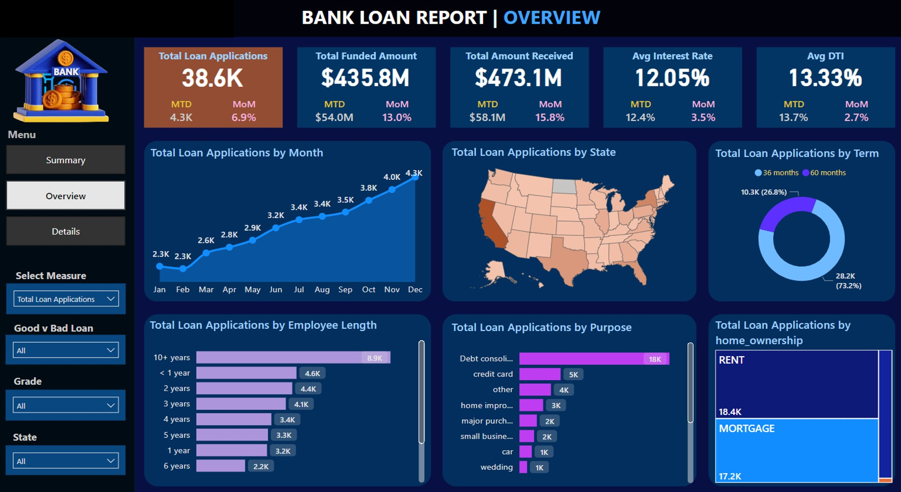
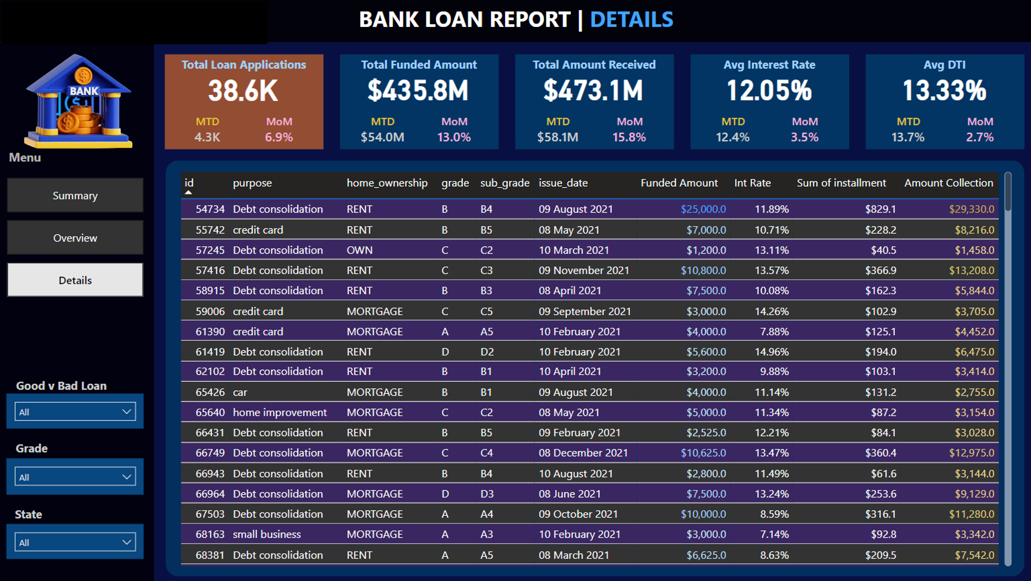

Slide 13
THANK YOU FOR YOUR TIME

